Slide 1
Learning intentions and success criteria
I am learning…
I can…
About standard algorithms
How to implement the three standard algorithms in National 5
Describe what each of the three standard algorithms does
Create programs which use standard algorithms

Slide 2

Algorithms
An algorithm is a set of step-by-step instructions for a computer to perform a specific task.
There are three algorithms you need to know in National 5:
Traversing a 1-D Array
Input validation
Running total within a loop
All three use loops, so make sure you know how to use them!

Slide 3
Traversing a 1-D Array
This means going through an array from start to finish using a loop:
Names array | Value
Names[0] | “Joel”
Names[1] | “Billy”
Names[2] | “Hannah”
Names[3] | “Sarah”
Two examples:
Displaying each name to the user
Asking the user to change each name in the array

Slide 4
Traversing a 1-D Array
Displaying each name to the user:
Line 1 DECLARE names INITIALLY [“Alice”, “Bob”, “Charlie”]
Line 2 FOR counter FROM 0 TO 2 DO
Line 3 SEND names [counter] TO DISPLAY
Line 4 END FOR
Asking the user to change each name in the array:
Line 1 DECLARE names INITIALLY [“Alice”, “Bob”, “Charlie”]
Line 2 DECLARE name INITIALLY “ ”
Line 3 FOR counter FROM 0 TO 2 DO
Line 4 GET name FROM KEYBOARD
Line 5 SET names [counter] TO name
Line 6 END FOR

Slide 5
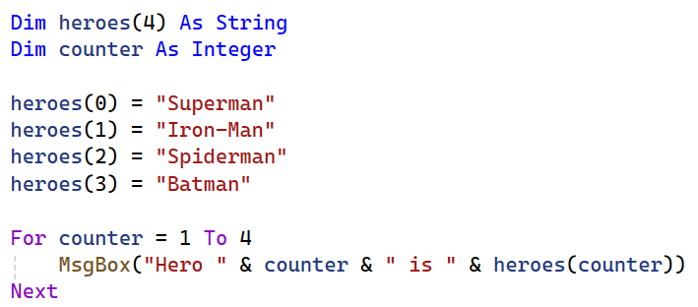
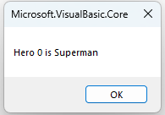
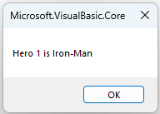
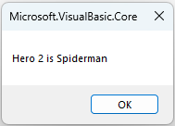
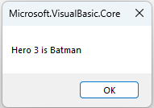
Traversing a 1-D Array
We can use a fixed loop to display each value in the array one-by-one:
Use a loop to display each value in the array

Slide 6
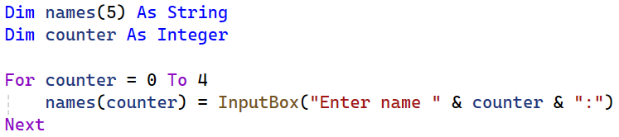
Traversing a 1-D Array
We can also get the user to populate the array:
In this example the program will ask:
Enter name 0:
Enter name 1:
Enter name 2:
Enter name 3:
Enter name 4:

Slide 7
Input Validation
Input validation is used to check that an input is acceptable before moving on:
E.g. to check a score input is between 1-100
E.g. to check a password is equal to a certain String
Pseudocode example:
Line 1 RECEIVE score FROM (INTEGER) KEYBOARD
Line 2 WHILE score ˂ 1 OR score ˃ 99 DO
Line 3 SEND “Enter a score between 1 and 99" TO DISPLAY
Line 4 RECEIVE score FROM (INTEGER) KEYBOARD
Line 5 END WHILE
By the end of this program, score MUST be between 1 and 99.

Slide 8
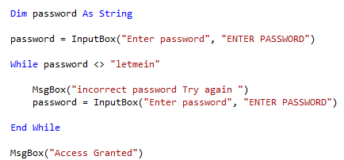
Input Validation
We can use a conditional loop to loop over and over until a condition is met:
This program will keep on looping until a valid input is entered.
It will only continue once the password is “letmein”

Slide 9
Running Total
Keeping a running total means keeping a note of the total throughout the program, instead of calculating it at the end:
Start with zero and keep adding until the final total is reached
Scores array | Value
Scores[0] | 5
Scores[1] | 3
Scores[2] | 4
Scores[3] | 1
Total: 0 (initial value)
Total: 0 + 5 = 5
Total: 5 + 3 = 8
Total: 8 + 4 = 12
Total: 12 + 1 = 13
Final total: 13

Slide 10
Running Total within a Loop
A running total is a cumulative sum:
On every loop, you increase the total (it accumulates)
total = total + number
Example pseudocode:
Line 1 DECLARE total INITIALLY 0
Line 2 FOR loop FROM 0 TO 4 DO
Line 3 RECEIVE number FROM KEYBOARD
Line 4 SET total TO total + number
Line 5 END FOR

Slide 11
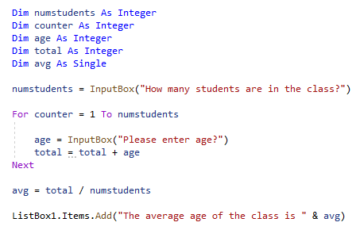
Running Total within a Loop
In this example, a running total is used to calculate the average age of a class:
The user decides how many times the program will loop
Every time the program loops, the total increases

Slide 12
Summary
An algorithm is a set of step-by-step instructions for a computer to perform a specific task.
There are three algorithms you need to know in National 5.
Traversing a 1-D Array:
Going through an array one-by-one
Input validation:
Checking a value until it is acceptable
Running total:
Keeping a sum/total as the program runs

Slide 13
Learning intentions and success criteria
I am learning…
I can…
About standard algorithms
How to implement the three standard algorithms in National 5
Describe what each of the three standard algorithms does
Create programs which use standard algorithms

